Slide 1


Santosh Kumar Kar,
skkar.2k2@gmail.com

Slide 2
CHAPTER – 6
JPA Data With Rest

Slide 3
Spring Data REST
Spring Data REST takes the features of
Spring HATEOAS and
Spring Data JPA
and automatically combines them together

Slide 4
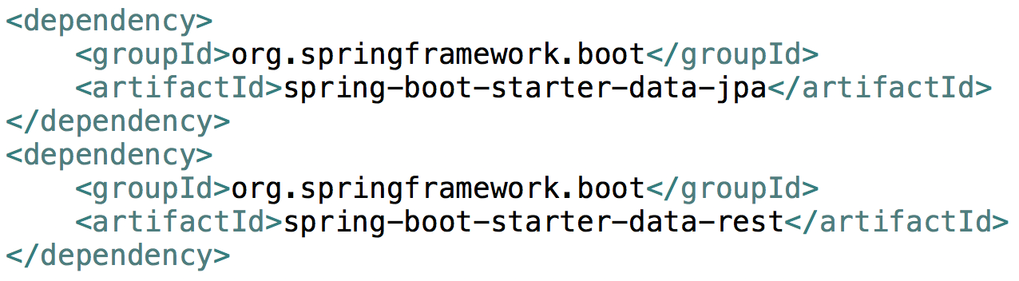
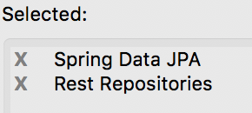
Spring Data Rest + JPA
Things to do
Add Driver dependency
Write the required repositories
Access the URL

Slide 5

Questions
Send to skkar.2k2@gmail.com

